Slide 1
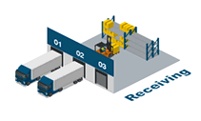
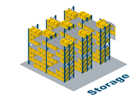
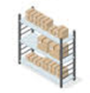
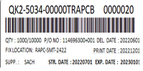
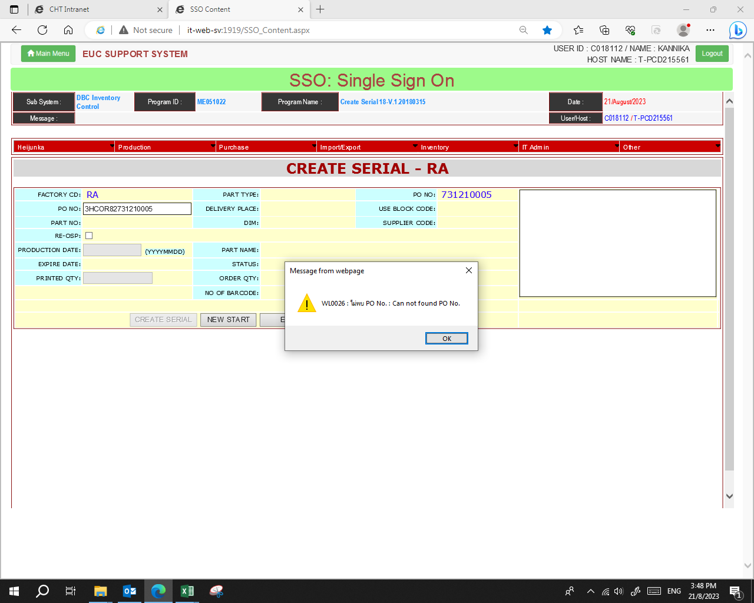
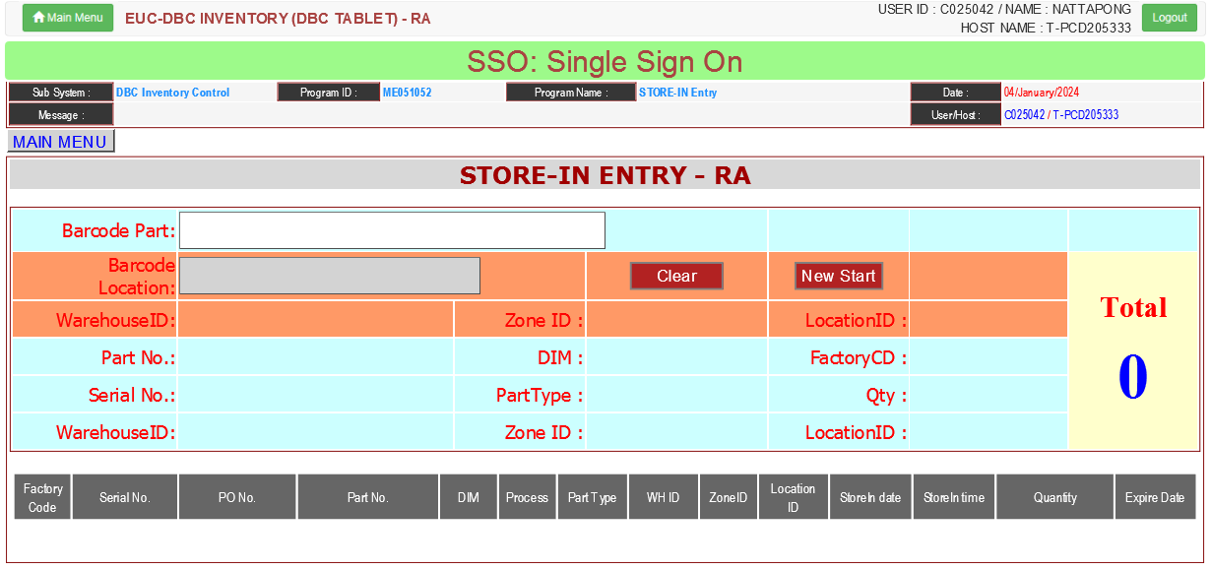




DBC-RA2
PLD
Operation flow
Receiving & Inspection
Free location
Store fixed
Move & Keep Part
Store-In
Warning Part
SSO
PCB
Warning Part
1.Serial No.
2.PO No
3.DC Code
Modify PCB System
Repackage
Store
[1] Man Check DC code & Create label
[2] System Sorting Serial refer. Expire date

Slide 2
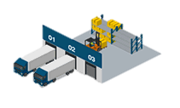
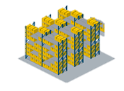
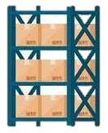


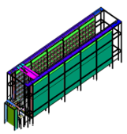
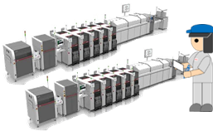


DBC-RA2
PLD
Operation flow
Current Operation at Child Part PCB
[1] Part Delivery
[2] Man Move to Free location
[3] Man Store-In to Fix location
[4] Man Pick part from Paper
Manual Kanban
PO Deleted
Serial Expire
Receive
PCB
Warning Part
Smart Store
Man MFG
Man Store
Man Store
Man Store
Auto Kanban
Obstruction for improvement
Condition of PO on system delete every 4 Month
Condition for request to ICS modify for deleted Data
PO status print all complete & Store-In all Complete
PO status close
Repack
[5] System Pick part from system request
List Part Repack
[1] Zone T
[2] Smart Store
[3] Strategic Part
Target Operation at Child Part PCB
Manual Kanban
PO Deleted
Serial Expire
Receive
PCB
Warning Part
Smart Store
Man MFG
Man Store
Man Store
Man Store
Auto Kanban
Repack

Slide 3
DBC-RA2
PLD
Operation flow
Current Operation at Child Part PCB
Receive
Free location
Fix location
[4] Man Pick part from Paper
Manual Kanban
PO Deleted
Receive
PCB
Warning Part
Smart Store
Man MFG
Man Store
Man Store
Man Store
Auto Kanban
Repack
Target Operation at Child Part PCB
Manual Kanban
PO Deleted
Serial Expire
Receive
PCB
Warning Part
Smart Store
Man MFG
Man Store
Man Store
Man Store
Auto Kanban
Repack

Slide 4
DBC-RA2
PLD
Background
Issue
1) Part expired.
2) FI-FO control quality.
3) Manage outstanding stock by implementing IT systems to control
4) Reduce work load check expired parts
5) Link system Strategic stock / Combine / SSO

Slide 5







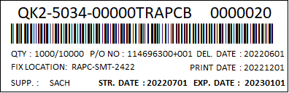

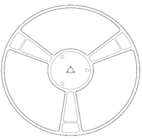





DBC-RA2
PLD
Current Operation at Child Part PCB
SSO system
1) Receiving
3) Free location
2) Create label ***
4) Store Fixed
5) MIZU
6) PCB_ASS’Y
Scan EDI [SIAM]
2.1) Unpack
2.3) Scan EDI slip
2.5) Print Create label
2.6) Attach serial label at parts
Double check
Conf. PNDB
Prepare part supply production
1) Store_PH1
Store_1
SMT
Store-in
Store_2
Store-out
Hand
2) Store_CIS
Scan serial in stock
Flow
Scan serial out stock
Store_3
PSU
3) Store_ADM
Child PCB
Min-Max stock
Strategy system
Combine
system

Slide 6






DBC-RA2
PLD
Improve Operation at Child Part PCB
SSO system
1) Receiving
2) Create label ***
3) Free location
4) Store Fixed
5) MIZU
6) PCB_ASS’Y
Scan EDI [SIAM]
2.1) Unpack
2.2) Check D/C
2.3) Scan EDI slip
2.4) Input D/C
2.5) Print Create label
2.6) Attach serial label at parts
2.7) Print cover list attach pallet parts
Double check
Conf. PNDB
Prepare part supply production
1) Store_PH1
Store_1
axx
axx
axx
bxx
bxx
bxx
SMT
cxx
Scan EDI
Regist location free
Keep part free location refer PO
cxx
cxx
Store-in
Store_2
Store-out
Hand
2) Store_CIS
axx
axx
axx
Flow
bxx
bxx
bxx
cxx
cxx
cxx
Scan serial in stock
Scan serial out stock
Store_3
PSU
Child PCB
SSO system
3) Store_ADM
axx
axx
axx
bxx
bxx
bxx
Min-Max stock
cxx
cxx
cxx
Calling parts
Order by D/C
Strategy system
Combine
system

